Slide 1
Session 15: Testing
Developing Real Systems for Customers
BML202/DAP507
Paul Kooner-Evans

Slide 2
Agenda
Last Weeks Directed Task
Be able to define an appropriate test strategy and test plan for a small development project
Understand the principles and various stages of software and systems testing

Slide 3
Broad Brush

Slide 4
Development & Testing is the phase where we develop a detailed understanding of the requirements and problems
Requirements Specification/ Feasibility Study
Systems Analysis
System and Software Design
Development and unit testing
Integration and system testing
‘Go Live’
Operation & maintenance

Slide 5
Is Testing Really Necessary?

Slide 6
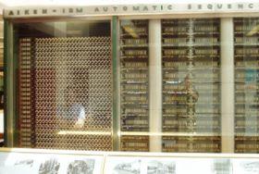
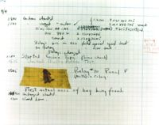
What is a computer bug?
In 1947 Harvard University was operating a room-sized computer called the Mark II.
mechanical relays
glowing vacuum tubes
technicians program the computer by reconfiguring components
Technicians had to change the occasional vacuum tube.
They started to get errors
Inspected
A moth flew into the computer and was zapped by the high voltage when it landed on a relay.
Hence, the first computer bug!
I am not making this up :-)

Slide 7
Bugs a.k.a. …
Defect
Fault
Problem
Error
Incident
Anomaly
Variance
Failure
Inconsistency
Product Anomaly
Product Incidence
Feature

Slide 8
Defective Software
We develop programs that contain defects
How many? What kind?
Hard to predict the future, however… it is highly likely, that the software we (including you!) will develop in the future will not be significantly better.

Slide 9
Sources of Problems
Requirements Definition: Erroneous, incomplete, inconsistent requirements.
Design: Fundamental design flaws in the software.
Implementation: Mistakes in chip fabrication, wiring, programming faults, malicious code.
Support Systems: Poor programming languages, faulty compilers and debuggers, misleading development tools.

Slide 10
Sources of Problems (Cont’d)
Inadequate Testing of Software: Incomplete testing, poor verification, mistakes in debugging.
Evolution: Sloppy redevelopment or maintenance, introduction of new flaws in attempts to fix old flaws, incremental escalation to inordinate complexity.

Slide 11
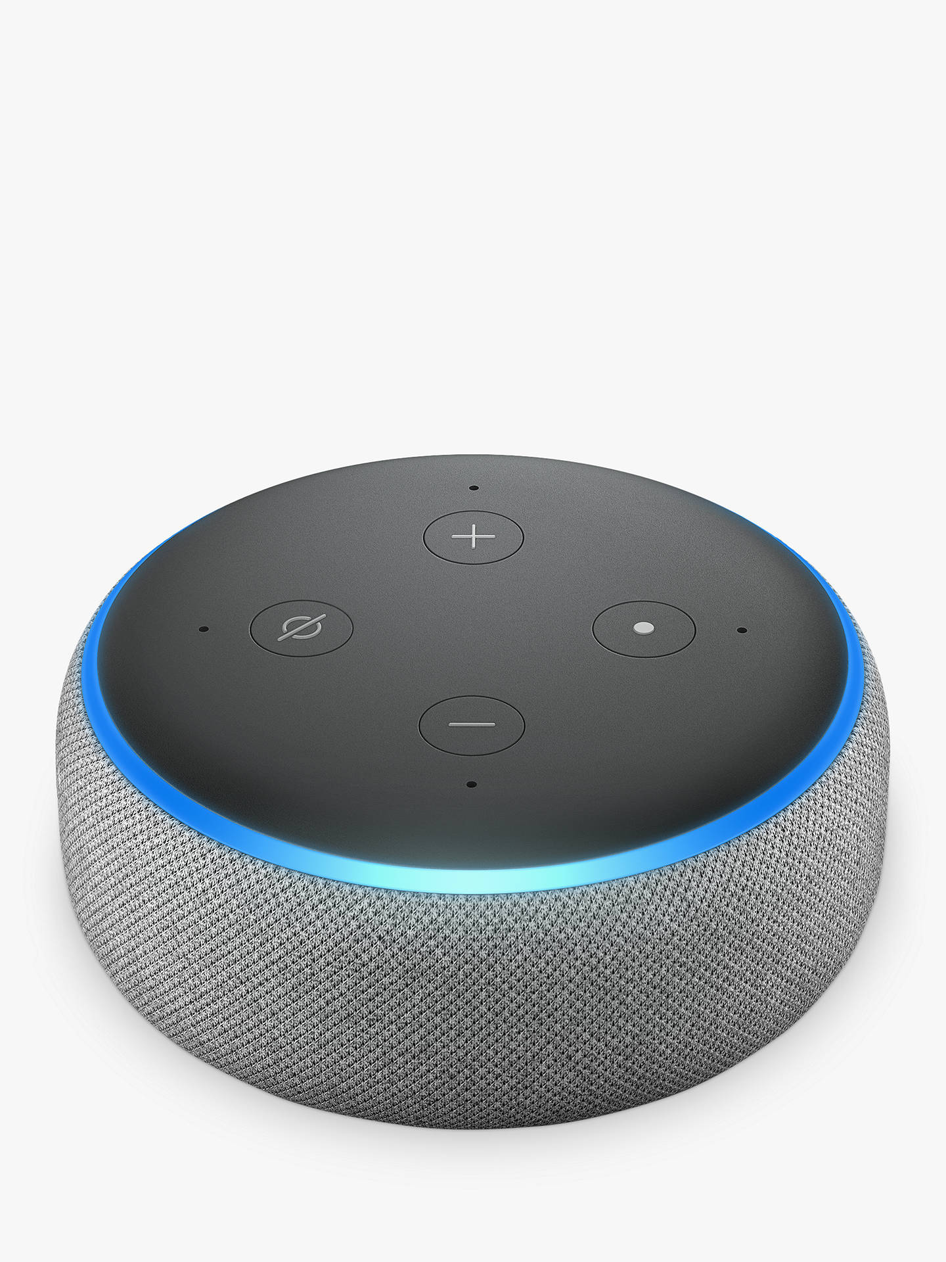
Prepare a Test Case (Original Echo less functionality than most recent)
What conditions do you need to test for re the basic commands:
On/Off
Volume Control
Using voice and/or buttons
Produce a basic plan that identifies condition states and expected responses.
Remember lights
Blue
Red
Yellow
White Volume

Slide 12
Verification and Validation
Validation – ‘Are we building the right system’
Verification – ‘Are we building the system right’
Boehm, Software Engineering Economics, 1981
Has two principal objectives
• The discovery of defects in a system
• The assessment of whether or not the system is useful and useable in an operational situation.

Slide 13
Verification, Validation, Testing
Verification: Demonstration of consistency, completeness, and correctness of the software artifacts at each stage of and between each stage of the software life-cycle.
Different types of verification: manual inspection, testing, formal methods
Verification answers the question: Am I building the product right?
Validation: The process of evaluating software at the end of the software development to ensure compliance with respect to the customer needs and requirements.
Validation can be accomplished by verifying the artifacts produced at each stage of the software development life cycle
Validation answers the question: Am I building the right product?
Testing: Examination of the behavior of a program by executing the program on sample data sets.
Testing is a verification technique used at the implementation stage.

Slide 14
Software Testing
Goal of testing
finding faults in the software
demonstrating that there are no faults in the software (for the test cases that has been used during testing)
It is not possible to prove that there are no faults in the software using testing
Testing should help locate errors, not just detect their presence
a “yes/no” answer to the question “is the program correct?” is not very helpful
Testing should be repeatable
could be difficult for distributed or concurrent software
effect of the environment, uninitialized variables

Slide 15
Testing usually consists of two different approaches….
Static
Verification
Requirements
Specification
High-level
design
Formal
Specification
Detailed
Specification
Program
Prototype
Dynamic
Validation
Static techniques can be used at all stages in the lifecycle. Dynamic techniques require the availability of a prototype or executable code
Source: Sommerville, I. (1998), Software Engineering, p 446

Slide 16
Static Verification Testing
Techniques
Inspections
Structured walkthroughs
Features
Peer participation
Products considered in advance of meeting
Predefined agenda and recorded outcome
No discussion of remedies for defects
Follow-up procedure checks defects fixed

Slide 17

Dynamic Validation is still the predominant form of testing
Requirements
Definition
Acceptance
Testing
Specification
Tested System
Systems
Design
Systems
Testing
Design
Validation
Integrated System
Detailed
Design
Integration
Testing
Component Design
Tested Units
Development
& Unit Testing

Slide 18
Types of Testing
Functional (Black box) vs. Structural (White box) testing
Functional testing: Generating test cases based on the functionality of the software
Structural testing: Generating test cases based on the structure of the program
Black box testing and white box testing are synonyms for functional and structural testing, respectively.
In black box testing the internal structure of the program is hidden from the testing process
In white box testing internal structure of the program is taken into account
Module vs. Integration testing
Module testing: Testing the modules of a program in isolation
Integration testing: Testing an integrated set of modules

Slide 19
Functional Testing, Black-Box Testing
Functional testing:
identify the the functions which software is expected to perform
create test data which will check whether these functions are performed by the software
no consideration is given how the program performs these functions, program is treated as a black-box: black-box testing
need an oracle: oracle states precisely what the outcome of a program execution will be for a particular test case. This may not always be possible, oracle may give a range of plausible values
A systematic approach to functional testing: requirements based testing
driving test cases automatically from a formal specification of the functional requirements

Slide 20
Structural Testing, White-Box Testing
Structural Testing
the test data is derived from the structure of the software
white-box testing: the internal structure of the software is taken into account to derive the test cases
One of the basic questions in testing:
when should we stop adding new test cases to our test set?
Coverage metrics are used to address this question

Slide 21
Unit Testing
Involves testing a single isolated module
Note that unit testing allows us to isolate the errors to a single module
we know that if we find an error during unit testing it is in the module we are testing
Modules in a program are not isolated, they interact with each other. Possible interactions:
calling procedures in other modules
receiving procedure calls from other modules
sharing variables
For unit testing we need to isolate the module we want to test, we do this using two things
drivers and stubs

Slide 22
Integration Testing – Units often have to be tested before the completion of the units with which they interact
A
B
C
D
E
F
G
H
I
J
K
L
M

Slide 23
Unit Testing lower level components may involve the preparation of a Driver
Driver
Test (input) Data
Test Results
Routine
Calls
Data flow as arguments/ parameters and function results
Driver accepts Test Case data, sends it to the Unit and displays the results for comparison with expected results
Unit (e.g. Class) under Test
H, I, L, M

Slide 24
Unit Testing mid-level components may involve the preparation of both a Driver and Stubs
Driver
Test (input) Data
Test Results
Routine
Calls
Data flow as arguments/ parameters and function results
Stubs are dummy units receiving input and returning appropriate output
Unit (e.g. Class) under Test
E, C, J, G
Stub 1
Stub 2
The preparation of Drivers and Stubs should be avoided

Slide 25
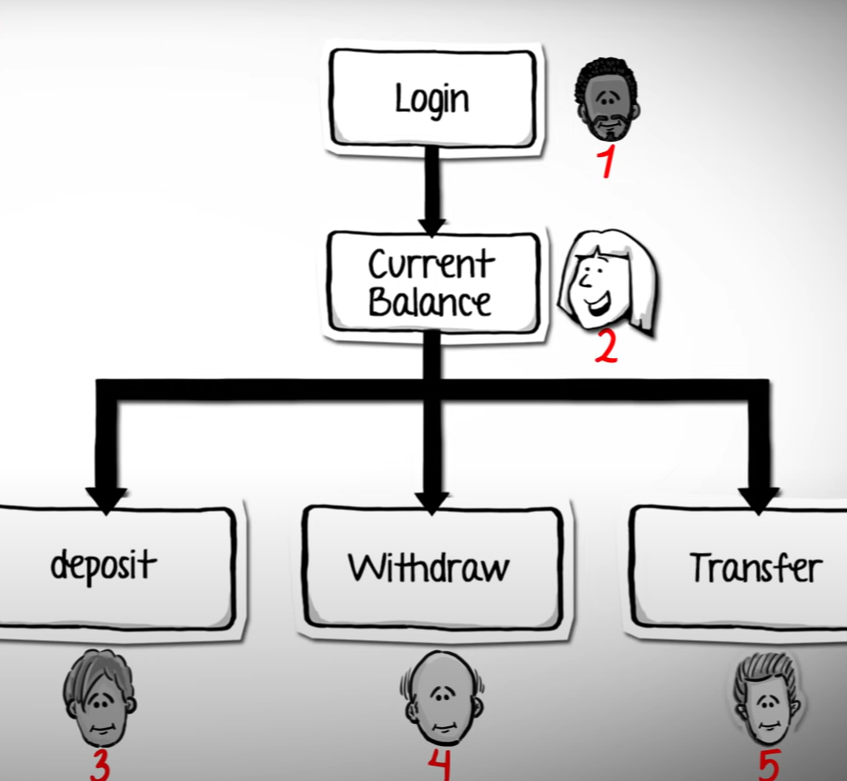

Slide 26
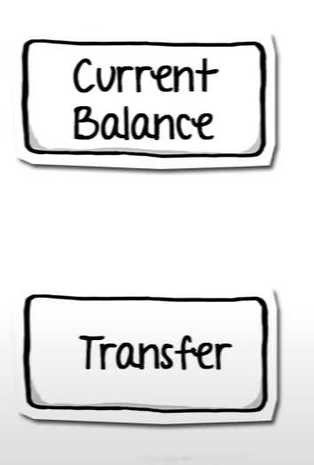
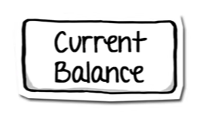
Transfer module not ready we use a ‘Stub’
Provides data that could be expected
And the ‘current balance’ responds appropriately
Stub

Slide 27
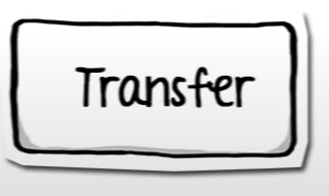
Current Balance module not ready we use a ‘Driver’
Driver
Provides data that could be expected
And the ‘Transfer’ module responds appropriately

Slide 28
Top Down Testing require Stubbs
Bottom up Testing require Driver

Slide 29
Testing Strategies
Top Down
Bottom-Up
Thread (Process)
Stress (Performance)
Back-to- Back

Slide 30
System Testing, Acceptance Testing
System and Acceptance testing follows the integration phase
testing the system as a whole
Test cases can be constructed based on the the requirements specifications
main purpose is to assure that the system meets its requirements
Manual testing
Somebody uses the software on a bunch of scenarios and records the results
Use cases and use case scenarios in the requirements specification would be very helpful here
manual testing is sometimes unavoidable: usability testing

Slide 31
System Testing, Acceptance Testing
Alpha testing is performed within the development organization
Beta testing is performed by a select group of friendly customers
Stress testing
push system to extreme situations and see if it fails
large number of data, high input rate, low input rate, etc.

Slide 32
Creating Test Plans for each phase of the cycle is critical
Purpose
Define standards for the tests
Provide an overview of test process to developers
Ensure appropriate resources are made available at the right time
Provide a document for approval by customer
Contents
Description of the testing process
Mapping to requirements specified
List of software and system components to be tested
Testing Schedule
Test recording procedures
Hardware and Software requirements
Constraints
A sample test plan has been input to Moodle

Slide 33
Test Reports
Defect ID | Bug description |  |  | Test Case ID | Priority | Severity | Open date | Status | Raised By | Tested on Version
 | Steps to Reproduce | Expected Results | Actual Results
1 | 1) Click on Delete Account 2) Enter required fields 3) Submit | 1) A pop - up "Do you really want to delete this account?" | No confirmation message shown | SM6 | Low | Low | 25/01/2014 | Closed | Tom Crook | v4
2 | 1) Click on Delete Customer 2) Enter Customer id 3) Submit | 1) A pop up "Do you really want to delete this customer?" | No confirmation message shown | SM11 | Low | Low | 25/01/2014 | Closed | Tom Crook | v4
3 | 1) Click on Edit Customer 2) Enter Customer id 3) Submit | 1)A pop - up "Customer does not exist" 2) Redirect to Delete customer | alert " You are not authorize to edit this account!" redirect to delete customer page | SM14 | Low | Low | 25/01/2014 | Closed | Tom Crook | v4
4 | 1) Click on Delete Customer 2) Enter Customer id 3) Submit | 1)A pop - up "Customer does not exist" 2) Redirects to Delete Customer | alert " You are not authorize to delete this account!" redirect to delete customer page | SM15 | Low | Low | 25/01/2014 | Closed | Tom Crook | v4
5 | 1) Execute the above test case 2) Refresh Fund Transfer detail page | Page should redirect to fund transfer page | Not redirecting to fund transfer page on clicking refresh button | SM17 | Low | Low | 25/01/2014 | Closed | Tom Crook | v4
6 | 1) Click on Fund Transfer 2) Enter all required fields 3) Submit | 1) A pop - up " Account # does not exist" | 1) A pop up "You are not authorize to Transfer Funds from this account!!" | SM19 | Medium | Low | 25/01/2014 | Closed | Tom Crook | v4
7 | 1) Cliick on Fund Transfer 2) Enter all required fields 3) Submit | 1) A pop up "You are not authorize to Transfer Funds from this account!!" | 1) A pop up "No details found for this account!!" | SM20 | Medium | Low | 25/01/2014 | Closed | Tom Crook | v4
8 | 1) Click on Fund Transfer 2) Enter all required fields 3) Submit | 1) A pop up "Payers account No and Payees account No Must Not be Same!!!" | No pop up and fund transfer sucessful or for non existing customer pop up "No details found for this account!!" is shown | SM21 | Medium | Low | 25/01/2014 | Closed | Tom Crook | v4

Slide 34
Directed Task
You should be developing!
(5 weeks to delivery 29th March Presentation)

Slide 35
Thank you
Meeting in Groups

